Slide 1

Pitch Presentation
Sakthiish -Graphics, Benjamin -Systems , Hao Zhe -AI, Jun Yi -Physics/Tech Lead

Slide 3
Escape from Digital Penitentiary
A Prison Break game where the player explores the map, obtain certain objects to aid their escape, without detection from guards.

Slide 4
Escape from Digital Penitentiary
A falsely accused criminal escaping from a maximum security prison

Slide 5
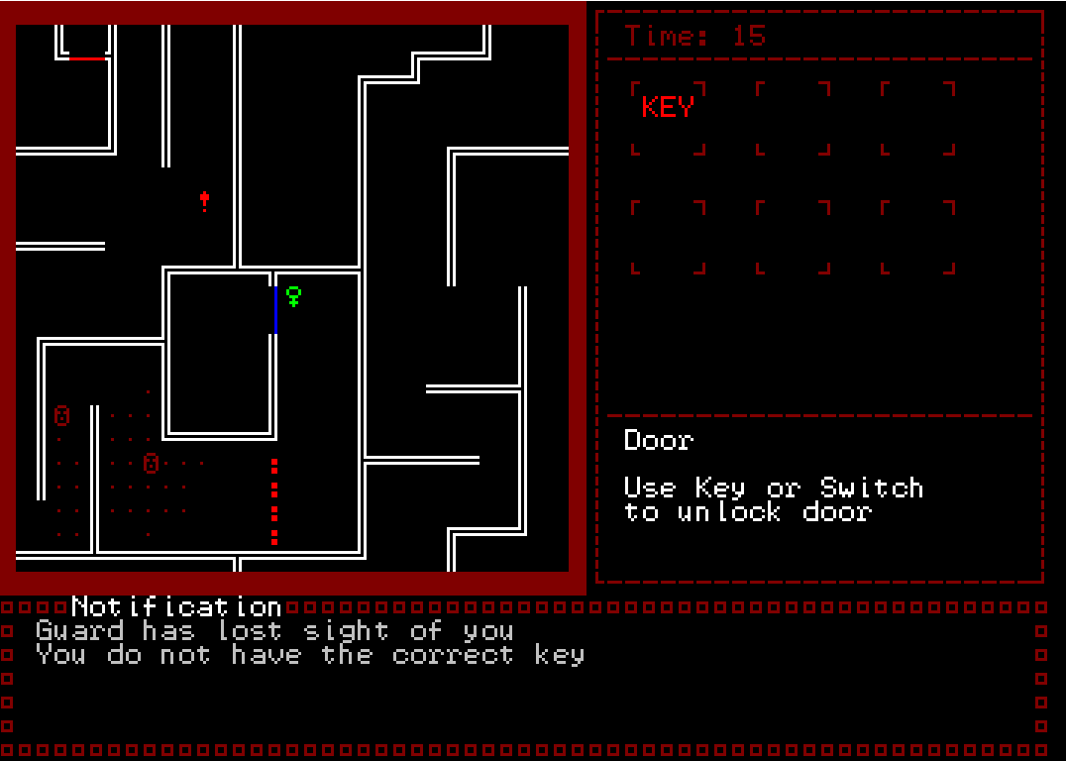
Game Overview
Camera
Top Down View
Console Text Based
Feel of the Game
Adrenaline
Intense feeling in a tense situation
Notes:
Each map will have a timer, after timer ends, the guards will come and catch you.

Slide 6

Core Features
Puzzle (Primary)
Stealth (Secondary)
Navigate around the level
Pickup items
Overcome locks/obstacles with items
Avoid the guards (Line of Sight)
Moving Guards
Guards offensive capability (Ranged Shooting)
Notes:
Our genre
Core game loop

Slide 7
Central Pillars
Exploration Movement Level Design Finding objectives Finding exit Planning stealth routes | Interaction Pick up items Use items Puzzle Design | Artificial Intelligence State machine Patrol movement Player detection Pathfinding Offensive abilities
Notes:
Workings of prison guard which can make interesting game decisions

Slide 8
Gameplay
Notes:
Current priority

Slide 9

Key Takeaway and Learnings
Time management
Plan to fail rather than failing to plan.
Debugging is key
Practice, Practice, Practice
Better coding structure and code clarity
Ask when in doubt
We don't have the time to experiment

Slide 10
Thank You
Notes:
We will reference how other games implement ascii graphics
Playtest the game out with players and see if they understand
Regular meetups to make sure we are on schedule
Playtest to make our level tight
Research and seek help from TA and lecturers

